Slide 1
Changing the Sampling Rate
Content and Figures are from Discrete-Time Signal Processing, 2e by Oppenheim, Shafer, and Buck, ©1999-2000 Prentice Hall Inc.

Slide 2
Changing the Sampling Rate
A continuous-time signal can be represented by its samples as
We can use bandlimited interpolation to go back to the continuous-time signal from its samples
Some applications require us to change the sampling rate
Or to obtain a new discrete-time representation of the same continuous-time signal of the form
The problem is to get x’[n] given x[n]
One way of accomplishing this is to
Reconstruct the continuous-time signal from x[n]
Resample the continuous-time signal using new rate to get x’[n]
This requires analog processing which is often undersired

Slide 3
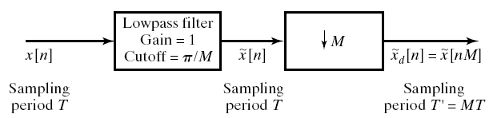
Sampling Rate Reduction by an Integer Factor: Downsampling
We reduce the sampling rate of a sequence by “sampling” it
This is accomplished with a sampling rate compressor
We obtain x_{d}[n] that is identical to what we would get by reconstructing the signal and resampling it with T’=MT
There will be no aliasing if

Slide 4
Sampling Rate Reduction by an Integer Factor: Downsampling
We reduce the sampling rate of a sequence by “sampling” it
This is accomplished with a sampling rate compressor
We obtain x_{d}[n] that is identical to what we would get by reconstructing the signal and resampling it with T’=MT
There will be no aliasing if
Anti-aliasing Filter

Slide 5

Frequency Domain Representation of Downsampling
Recall the DTFT of x[n]=x_{c}(nT)
The DTFT of the downsampled signal can similarly written as
$$X_{d}\left(e^{jω}\right)=\frac{1}{M}X\left(e^{j\left(\frac{ω}{M}\right)}\right)$$
Let’s represent the summation index as
And finally

Slide 6
Frequency Domain Representation of Downsampling
Recall the DTFT of x[n]=x_{c}(nT)
The DTFT of the downsampled signal can similarly written as
$$X_{d}\left(e^{jω}\right)=\frac{1}{M}X\left(e^{j\left(\frac{ω}{M}\right)}\right)$$
Let’s represent the summation index as
And finally

Slide 7
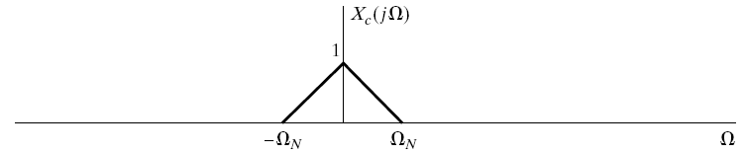
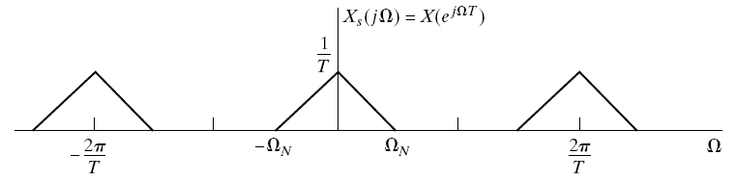
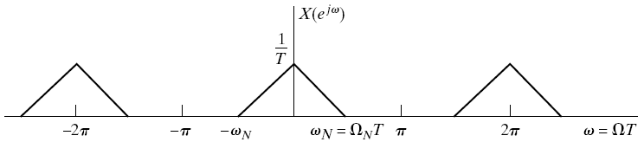
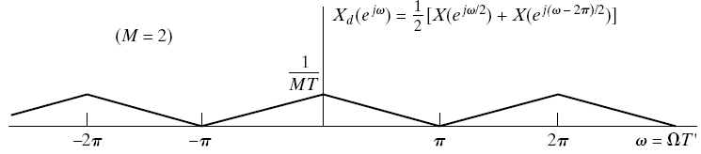
Frequency Domain Representation of Downsampling: No Aliasing
$$\frac{π}{2}$$

Slide 8
Important Points
Downsampling in time domain means you are squeezing the signal in time domain.
This squeezing in time is reflected as expansion in frequency domain, so spectrum expands and scaled down.

Slide 9
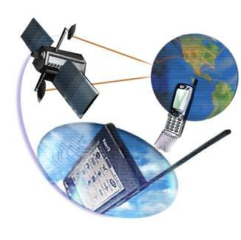
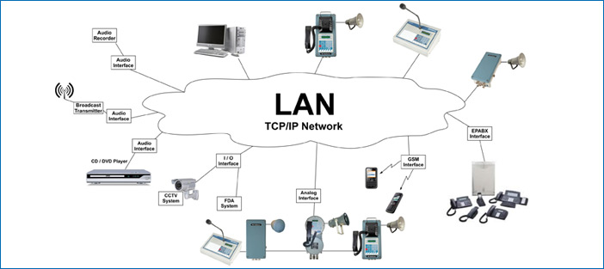
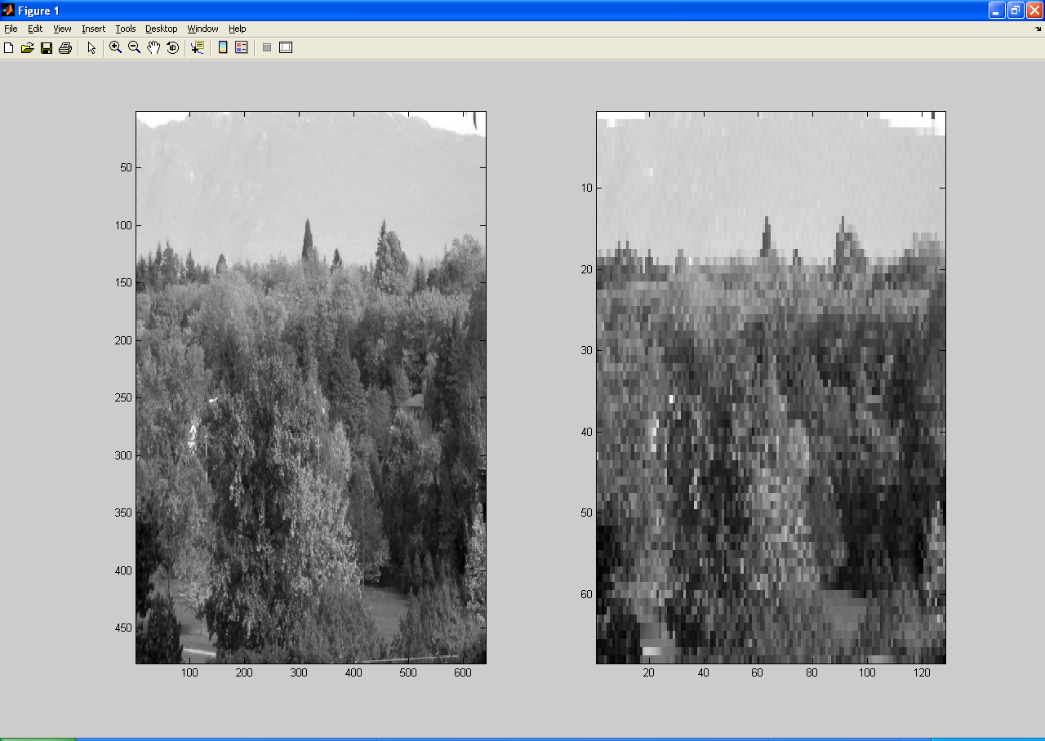
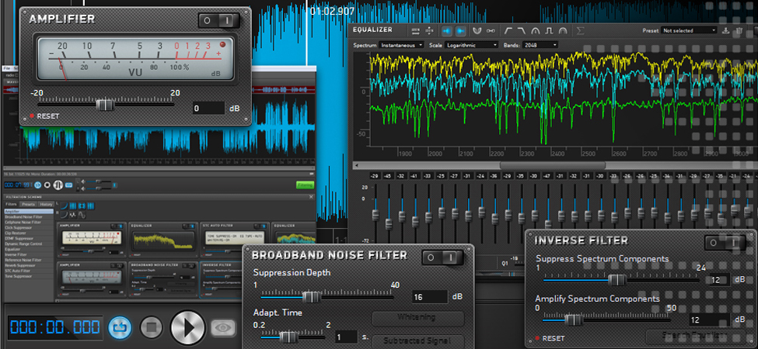
Application of downsampling
Communication system (where specs of hardware mismatch)
Audio/Image Processing

